Slide 1
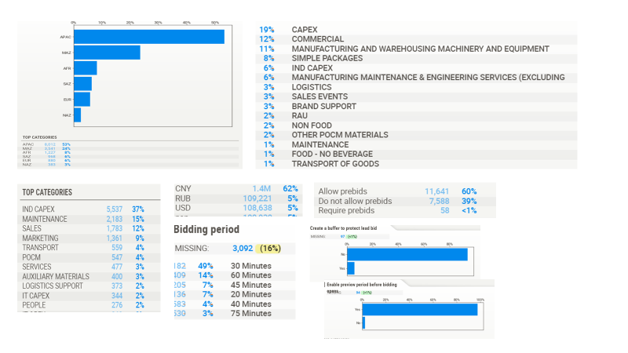
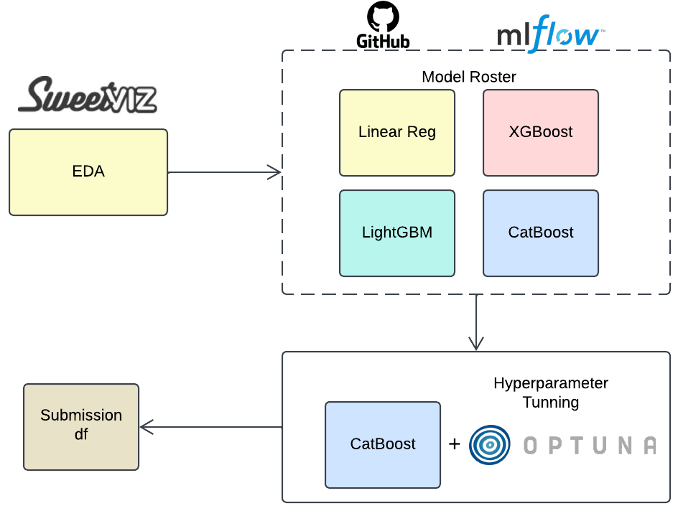
JOURNEY
Exploratory Data Analysis (EDA):
Conducted extensive analysis to understand the dataset.
Explored relationships between variables to assess their impact on outcomes.
Modeling Journey:
Started with simple linear models to assess feature Explainability.
Progressed to advanced models like XGBoost and Gradient Boosting Machine (GBM).
Finalized on CatBoost its best predictive performance.
Hyperparameter Optimization:
Leveraged Optuna for fine-tuning CatBoost's hyperparameters to achieve optimal results

Slide 2





Strategy
Auction EDGE
Invitee List
Pricing
Consider quantity size to make sure MOQ of suppliers are considered
Have a good mix of Large/Small and New/Old Suppliers
Consider historical OTD, quality and ethical sourcing
Use historical bid and inflation rates to get the optimum starting point. Ensure it leaves room for competitive bidding.
Consider economic conditions, seasonal demand, or shortages that may impact pricing
Supplier Financials
Ways of Working
Check on financials of suppliers available
Helps on risk mitigation and supplier can meet contractual obligations
Enables for a better PT as per their financials
Maintain transparency by providing live updates on bids to keep suppliers engaged
Have a post auction negotiation to align on terms like delivery timelines, quality assurance etc.

Slide 3
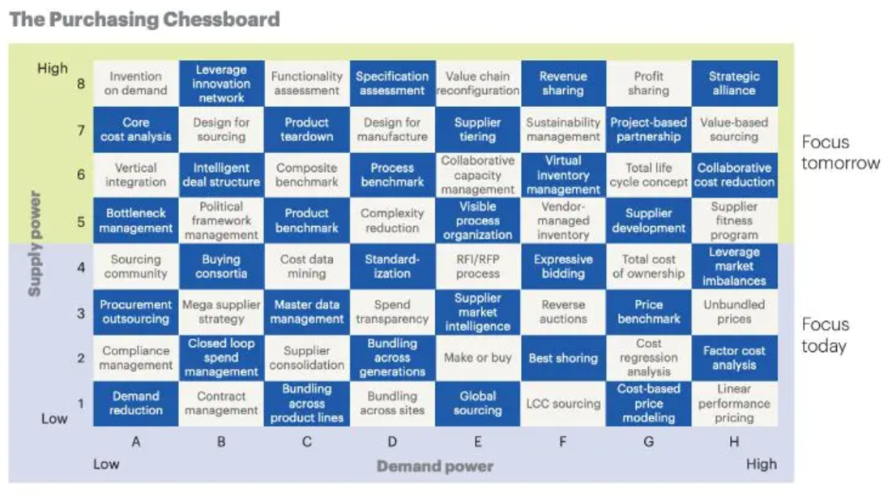
WHY 64 CHESSBOARD SOURCING SHOULD BE TRIED?
This strategy uses the interplay between supply power and demand power to select the most effective procurement approach. It provides 64 levers (strategies) based on how much control the supplier or buyer has in the relationship.
Supply Power
How much control suppliers have over the market.
High supply power: Suppliers dictate prices or have unique offerings.
Low supply power: Buyers have many alternatives or substitutes.
Demand Power
How much control buyers have over the market.
High demand power: Buyers can influence terms through scale or alternatives.
Low demand power: Buyers rely heavily on specific suppliers.
Notes:
This Purchasing Chessboard is a strategic sourcing tool that categorizes different procurement strategies based on two main axes: supply power (the leverage suppliers have in the relationship) and demand power (the leverage the buyer has). It is designed to help procurement professionals decide the best sourcing strategy to adopt, depending on the current market dynamics, supplier relationships, and the buyer’s needs.
Explanation of Key Elements for a General Audience:
Supply Power (Vertical Axis): This represents how much control or leverage the supplier has in the market. If a supplier has a unique product or limited competition, they have high supply power.
Demand Power (Horizontal Axis): This shows how much control or leverage the buyer has over the supply market. If there are many suppliers, the buyer has more demand power; if the buyer is one of the few, the power is lower.
Key Strategies in the Chessboard (with an Example)
High Supply Power and Low Demand Power (Top-left corner):
Strategy: "Invention on Demand"
This is where the supplier has the upper hand because there are limited options available. The buyer’s best option is to encourage innovation by working closely with the supplier to develop new solutions.
Example: A car manufacturer needing a very specific, advanced technology from a limited supplier might collaborate with the supplier to create new features or designs that could meet their needs.
High Supply Power and High Demand Power (Top-right corner):
Strategy: "Strategic Alliance"
In this case, both the supplier and the buyer are important to each other, so they form a long-term partnership. This could involve sharing risks, rewards, and investments.
Example: A technology company forming a partnership with a component manufacturer to jointly develop a new product line, ensuring both sides benefit from the innovation and shared market insights.
Low Supply Power and Low Demand Power (Bottom-left corner):
Strategy: "Contract Management"
This strategy is focused on negotiating basic agreements that protect both the buyer and supplier. There’s limited room for leveraging prices, so managing contracts effectively is crucial.
Example: A small business purchasing raw materials in small quantities from multiple suppliers would focus on ensuring terms are clear and favorable within a contract, since neither side has much leverage.
Low Supply Power and High Demand Power (Bottom-right corner):
Strategy: "Best Shoring"
This strategy aims to optimize the location of suppliers based on cost, quality, and delivery times. The buyer has the upper hand, so they can negotiate better terms by focusing on global sourcing.
Example: A multinational company sourcing components from several countries to ensure the best quality at the lowest price, based on the buyer’s ability to drive competition among suppliers.
Key Takeaways for an Audience with No Background:
The chessboard helps buyers choose the right sourcing strategy based on their position in the market (how much influence they have) and the position of suppliers (how much influence they have).
Strategies vary depending on whether the buyer has strong negotiating power or not. Some strategies focus on innovation and long-term partnerships, while others focus on getting the best deal by sourcing from multiple suppliers.
The goal is to select the strategy that aligns with current market conditions, supply capabilities, and the buyer's needs.

Slide 4
Rules | Type | min | max | should be used with
Time Between Lot Closing | Time | 0 | 10 | specifyhowlotbiddingwillbeginandend_Serial
Can Owner See Responses Before Event Closes _Yes | Binary | 0 | 1
Can Participants place Bids During Preview Period _Do Not Allow Pre-Bids | Binary | 0 | 1
Can Participants Place Bids During Preview Period _Require Pre-bids | Binary | 0 | 1
Can Participants See Ranks? _No | Binary | 0 | 1
Can Participants See Ranks? _Their Own Rank | Binary | 0 | 1
Can Participants See Ranks? _Their Own Rank When Leading | Binary | 0 | 1
Can Participants Submit Tie Bids _no Tie Bids | Binary | 0 | 1
Can Participants Submit Tie Bids _no Tie Bids For Rank 1 | Binary | 0 | 1
Can Participants Submit Tie Bids _No Tie Bids For Rank 2 Or Better | Binary | 0 | 1
Can Participants Submit Tie Bids _no Tie Bids For Rank 3 Or Better | Binary | 0 | 1
Create A Buffer To Protect Lead Bid _yes | Binary | 0 | 1
Enable Preview Period Before Bidding Opens _yes | Binary | 0 | 1
Enable Traffic Light Bidding _Yes | Binary | 0 | 1
Improve Bid Amount By _Percentage | Binary | 0 | 1
Indicate To Participants That Participant-specific Initial Values Have Been Specified _Yes | Binary | 0 | 1
Require Participant To Give Areas On For Declining To Bid _Yes | Binary | 0 | 1
Set Are View Period After Lot Or Item Closes _yes | Binary | 0 | 1
Show Line-Item Level Rankin Lot _yes, To Buyers And Participants | Binary | 0 | 1
Show Line-Item Level Ranking Lot _Yes, To Buyers Only | Binary | 0 | 1
Show Calculated Value Of Competitive Term Before Participant Submits Bid _Yes | Binary | 0 | 1
Show Formulas To All Participants _yes | Binary | 0 | 1
Show Lead Bid To All Participants _No | Binary | 0 | 1
Show Lead Bid To All Participants _yes | Binary | 0 | 1
Specify How Lot Bidding Will Begin And End _Serial | Binary | 0 | 1 | Time between lot closing
Specify How Lot Bidding Will Begin And End_ Staggered | Binary | 0 | 1
Specify How Participants View Market Information _Enable A Starting Gate For Each Lot | Binary | 0 | 1
Specify How Participants View Market Information _Enable One Starting Gate For The Entire Event | Binary | 0 | 1
Set Are View Period After Lot Closes _Yes | Binary | 0 | 1
Day _ type_ weekend | Binary | 0 | 1
Bidding Period | Time | 0 | 100
Bid Rank That Triggers overtime | Int | 0 | 5 | Allow bidding overtime
Review Time Period | Time | 0 | 10
Allow Bidding Overtime | Binary | 1 | 0 | bid rank that triggers overtime

Slide 5




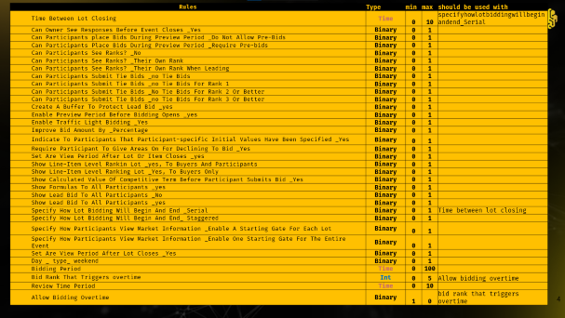
AUCTION VARIABLES TO MODIFY FOR MAX EFFICIENCY
Binary variables
Logical Constraints
Can participants place bids during preview period?
Improve bid amount by percentage?
Show line-item level rank in lot to buyers and participants?
Enable traffic light bidding?
Set a review period after lot closes?
Can participants see ranks?
Continuous variables
Review time period ?
Bidding period ?
Overtime period(minutes)?
Bid rank that triggers overtime?

Slide 6

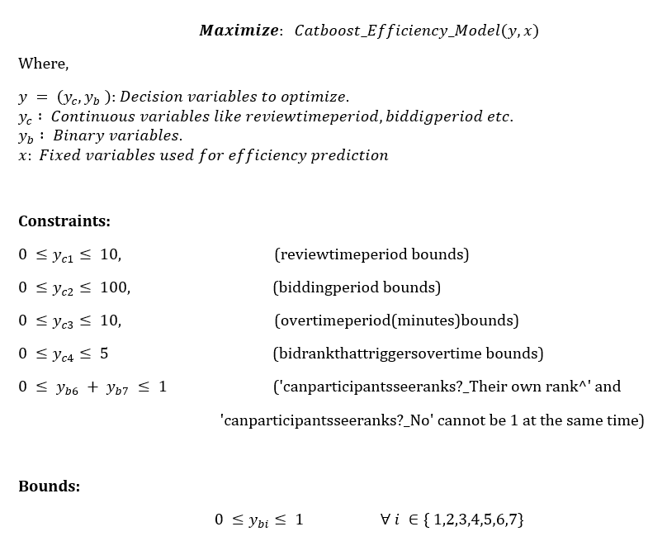


OPTIMISATION LAYER
Optimized for events at 3 different hierarchies to mitigate asymmetric bias in data
CATEGORY
ZONE
ZONE x CATEGORY
Events
Events
Events
The optimization algorithm used is COBYLA
(Constrained Optimization BY Linear Approximations)
numerical optimization algorithm designed for solving constrained optimization problems where the objective and constraint functions are nonlinear and can be evaluated but do not have a known gradient (In our case Catboost.)

Slide 7
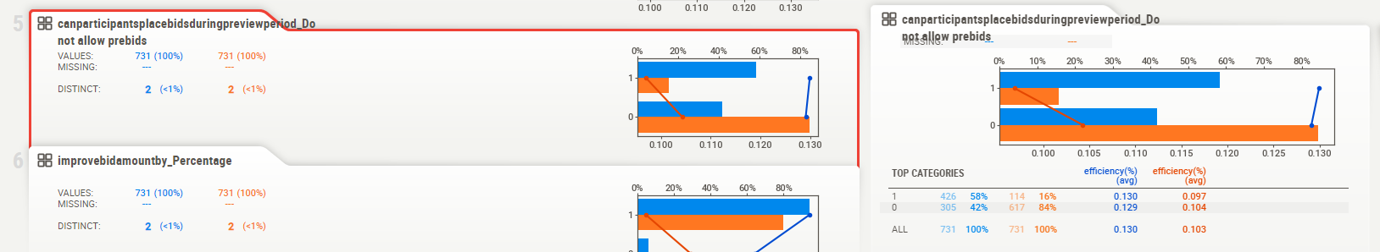
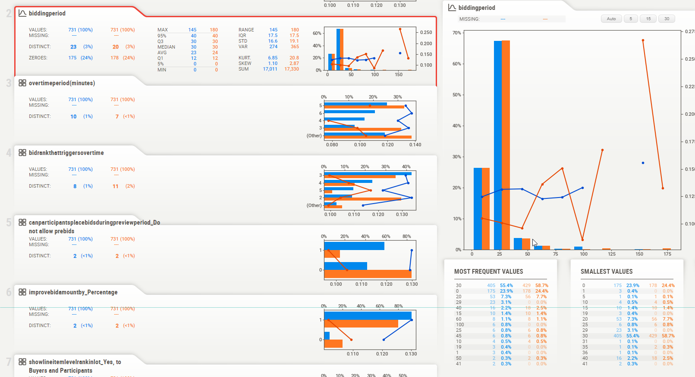

Slide 8




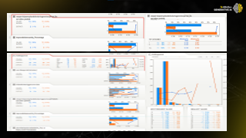
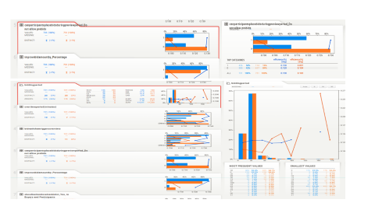
INSIGHTS TO CHANGE OF AUCTION RULES
Insights here are for a section of APAC-Commercial events
It is preferred to not allow prebids during preview period
Bidding period in current auctions at 30 mins is almost optimal
Allow suppliers to see their ranks 90% of the time. Currently the data has a ~50% split
Review time period is optimum at 3 minutes instead of 2 minutes used currently

Slide 9



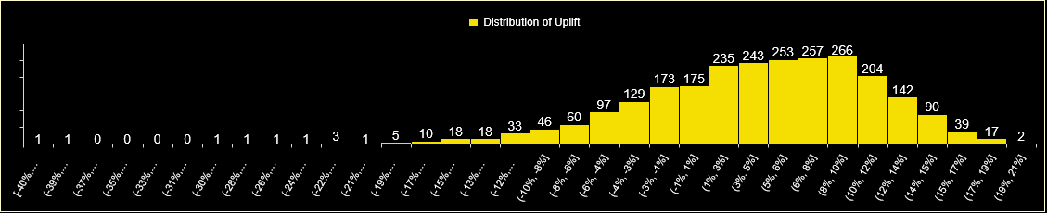
SO WHAT?
Providing the optimal auction rules for 2502 events across X- Region would enable to find an opportunity of $77Mn
5.2%
8-10%
$77M
Improvement to Uplift
Optimized Savings
Most frequent uplift range (*266)
Distribution of uplift, forms a normal distribution curve where most uplift numbers fall between 1 to 12%
Event Count | Initial efficiency | Optimized_efficiency | Average of Uplift | Opportunity | Initial Final Spend | Optimized Final spend | Baseline Spend
2502 | 18.1% | 23.3% | 5.2% | 77 M | 1.22Bn | 1.15Bn | 1.5Bn
Notes:
This slide starts after the demo where the value is shown with an example
Story line We see the distribution of NAZ Zone below. Normally distributed uplift numbers where maximum uplift seen between 4 to 9%
We need to show a total of value when the new optimum variables are used for all events (Showcase the count), current spend, optimum spend and total savings
If we can show th uplift across zones and their values would be good

Slide 10
SCOPE OF IMPROVEMENT
1
Spend ample amount of time to understand other data sources affecting effectiveness. Consider looking into macro economic factors.
2
3
Model and Parameter optimization and advance techniques
Exploring Optimization techniques and exploring more local optimization
incorporating stricter penalty functions to maximise efficiency with auction rules conformed
4
Ariba rules review and efficiency mapping
Introduce prescriptive analysis enablement

